Slide 1

Predicting Popularity with Spotify
IST 718 - Group 6
Jacob Kahane, Emani Jones, Shivangi Mundhra

Slide 2

Project Overview
Background:
Music consumption has evolved with the rise of streaming platforms, which offer an abundance of content
Spotify arrived in the US in 2011 and has grown to over 400 million active users
With so much music available, Spotify and other streaming platforms curate playlists for users, but there is a need for a more accurate prediction algorithm
Objective:
Develop a prediction algorithm to determine a new song's potential popularity on a streaming platform, based on song characteristics and user preferences

Slide 3
Prediction, Inference, & Goals
Prediction: Song Popularity, User Preference, & Song Recommendations
Using Decision Trees, Naive Bayes, & Random Forest we will attempt to build a machine learning model capable of predicting whether or not a song will be popular
Using Logistic Regression & Decision trees we will take a subset of the data and attempt to predict whether a specific user will like a particular song
Using K-means clustering we will try and recommend songs that users will like based on the other songs that they already like
Inference: Determining which factors influence popularity & variations by genre
Using linear regression on the dataset as a whole with dummy variables we will look to see if genre is influencing song popularity
Using individual linear regression for each genre we will look to see if the variables that determine popularity vary by genre
Additional comparison with PCA components will look to see if PCA analysis will have components that are specific to each genre

Slide 4
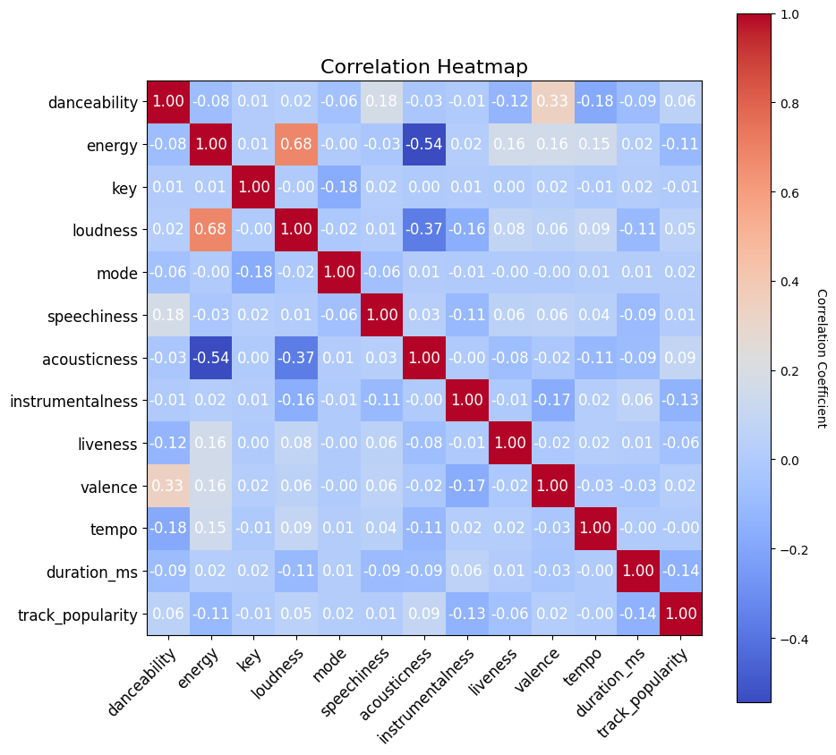
Data Exploration
Check for correlation issues between the variables of interest
Check for differences between genres in terms of the distribution of the variables of interest

Slide 5
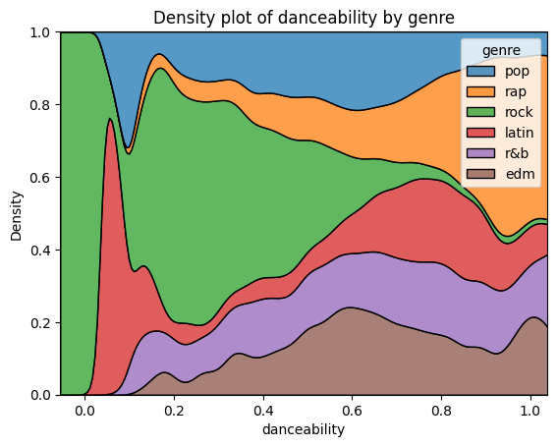
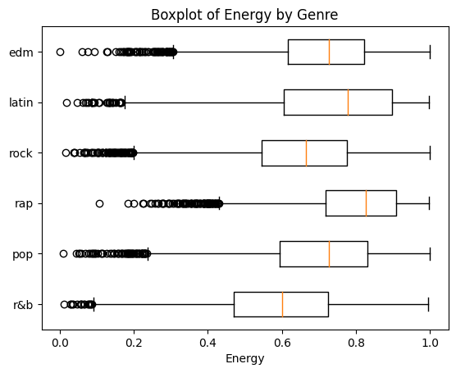
Differences between genres can be seen in the distribution of important variables

Slide 6
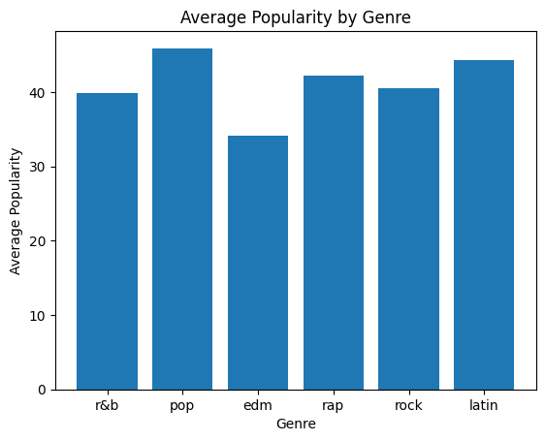
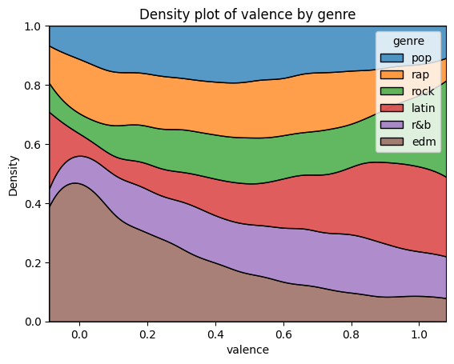
Additional variation by genre can be seen here

Slide 7
Methods: Regression & PCA
Data Preparation & Cleaning
Convert data types, remove unnecessary columns, eliminate null values & duplicates
Linear Regression with binary dummy variables for each genre
Individual regressions for each genre
Principal Component Analysis
6 components - same as number of genres

Slide 8
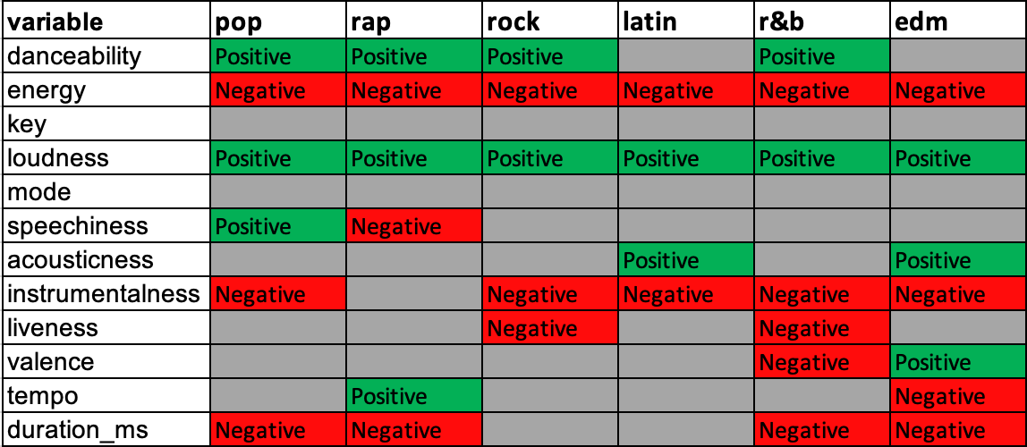
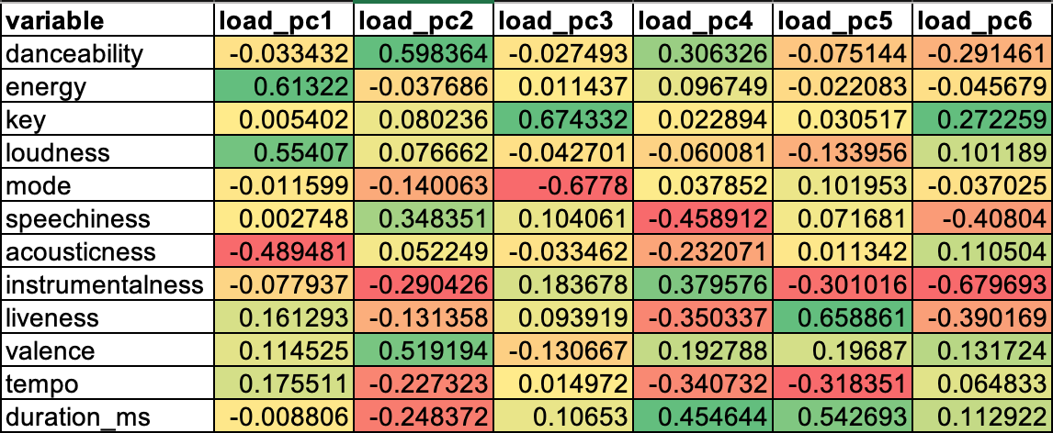
Results: Regression & PCA
In the individual regressions, we are able to see that each genre has a different set of significant factors
Above you can see the variables that were significant for each regression along with the direction of significance
Results of the PCA analysis can be found in the graph below.
The linear regression with dummy variables for genres shows that genre is a significant variable.

Slide 9

Methods: Predicting Popularity
Since we have multiclass labeling, we must use decision trees, random forest and naive Bayes classification
Used scaled numeric features, as well as one hot encoded genres as input features

Slide 10
Models
I used ParamGridBuilder to find the best model for each classifier.
Decision Trees
Depth:5
Nodes=39
Classes=4
Naive Bayes
Had to replace all negative values with 0
Class =3
Smoothing = 1
Random Forest
# of trees: 30
Depth: 5
Bins:50

Slide 11
Results
3 Fold Cross Validation
Accuracy of Models
Decision Trees- 41.83%
Random Forest - 43%
Naive Bayes- 50.19%

Slide 12

Methods: Predicting User Preferences
Took a subset of 300 songs
Approximately 1% of the data
Create a binary variable notating which songs a user likes
Ideally users can export the data, manually enter which songs they like, then load data back in
For test purposes we randomly assigned a 1 or 0 to songs to simulate a user’s preference
Split data into test and train
70-30 split
Standardize the data
Evaluated using both Logistic Regression & Decision Tree models

Slide 13
Results: Predicting User Preferences
Models were evaluated using the AUC values
Results for the Logistic Regression Model returned an AUC score of 0.49402
Results for the Decision Tree Model returned an AUC score of 0.49755
Both models performed similarly, but results of the Decision tree model is slightly higher
Both results are low, but this can be explained by the fact that we randomly assigned user preference. Most users would likely have a more discernible pattern

Slide 14
Method: K Means Clustering for Song Recommendations
Using K means Clustering, we will cluster the songs to provide listeners with song recommendations, based on the song they are currently playing
Used all numerical values and one hot encoded genre variable as features in clustering
Used PCA to graph data on two dimensional graph

Slide 15
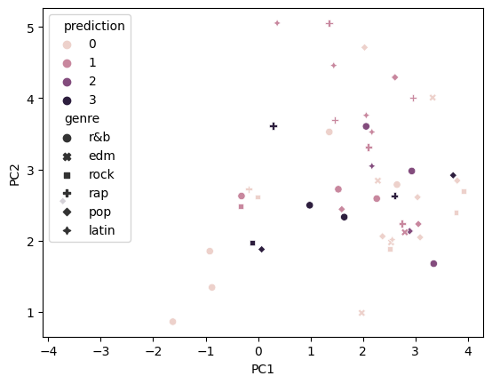
Graph of Clustering Results

Slide 16
Problems Encountered
Difficulty comparing models results caused us to change techniques
K-means to Decision Tree for predicting user preference
K-nearest neighbor to Random Forest, Decision Tree, and Naive Bayes for predicting popularity
Not all graphing methods were available in spark
Converted to pandas to graph
Couldn’t use binary classification because of our multiclass labeling

Slide 17
Conclusions
Based on the initial data exploration we can see that there are significant difference between the genres in terms of distribution of key variables
The regression results show that although there are similarities between the genre’s the factors that determine popularity are different
The pca factors do not see to mirror the results of any specific genre regression meaning that the factors do not help predict a certain genres’ popularity
In predicting user preference, the Decision tree model slightly out performed the logistic regression model, both auc levels were low but that can be explained by the random assignment of user preferences
Naive Bayes performed the best out of the multiclass classifiers

Slide 18
Future Scope
Using binary classification instead of multiclass classification
SVM, Logistic Regression, GBM
Incorporate PCA in the classification models
Incorporating release date to determine if that has an impact on popularity

Slide 19
Group Member Contributions
Shivangi - Data exploration & cleaning, Linear Regression with Dummies
Emani - Predicting Popularity using Random Forest, Naive Bayes, and Decision trees, Song recommendations using k-means clustering
Jacob - Linear Regression, PCA, Predicting user preferences using logistic regression and Decision trees

Slide 20
Data Source
https://raw.githubusercontent.com/rfordatascience/tidytuesday/master/data/2020/2020-01-21/spotify_songs.csv

